Slide 1
Lecture 11 – Message Sequence Descriptions & Transitioning from Analysis to Design
COMP 3700: Modeling and Design
Chapter 9.2.4: Message Sequence Description
Chapter 11: State-Dependent Dynamic Interaction Modeling
Gomaa, 2011

Slide 2
Message Sequence Description
Supplementary documentation which is useful to provide with an interaction diagram
Developed as part of the dynamic model and describes how the analysis model objects participate in each use case as depicted on an interaction diagram
Narrative description describing:
What happens when each message arrives at a destination object depicted on an interaction diagram
Uses the message sequence numbers that appear on the interaction diagram
Describes the sequence of messages sent from source objects to destination objects and
Describes what each destination object does with a message it receives
Usually provides additional information not depicted on the object interaction diagram
Ex: which attributes of the object are referenced when an entity object is accessed
Examples of message descriptions are shown on page 144 in your text
Section 9.5.2 as a part of steps 3 and 4

Slide 3
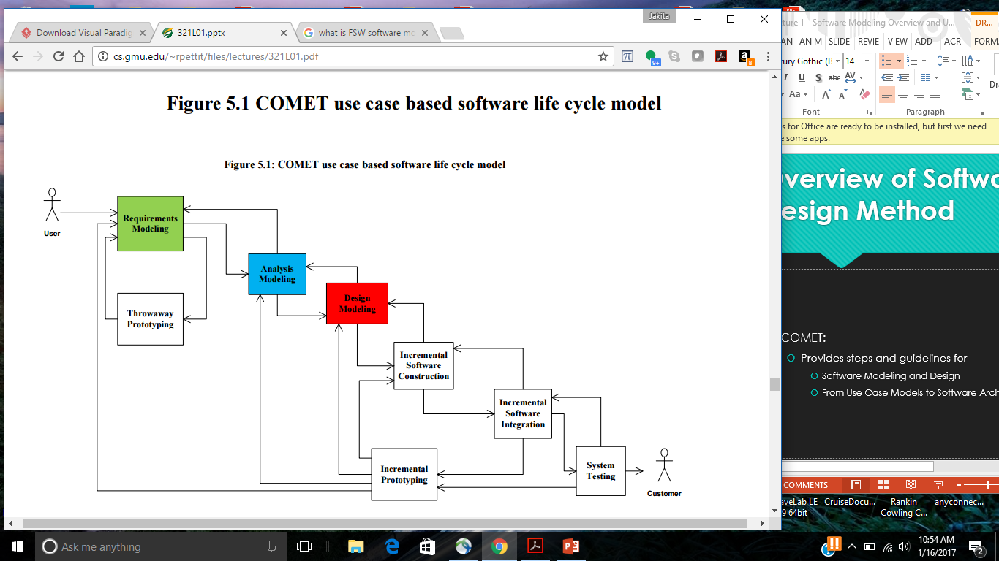
COMET Use Case Based Software Life Cycle Model
Develop Software Requirements Model
Develop Software Analysis Model
Develop Software Design Model
Design Overall Software Architecture (Chapter 12, 13)
Design Distributed Component-based Subsystems (Chapter 13, 15)
Structures Subsystems into Concurrent Tasks (Chapter 18)
Design Information Hiding Classes (Chapter 14)
Design Detailed Software Design
First, we must transition from Analysis to Design

Slide 4
Transition from Analysis to Design: Integration of Communication Diagrams
Used to determine overall structure of system
Merger of communication diagrams
Start with first communication diagram
Superimpose other communication diagrams
Add new objects and new message interactions from each subsequent diagram
Objects and interactions that appear on multiple diagrams are only shown once
Consider alternative scenarios for each use case
Integrated communication diagram
Shows all objects and their interactions

Slide 5
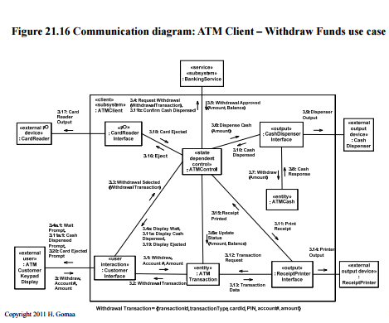
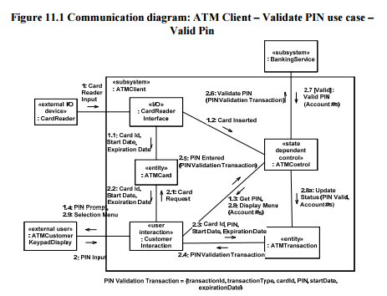
Example: ATM Client
Start with first communication diagram

Slide 6
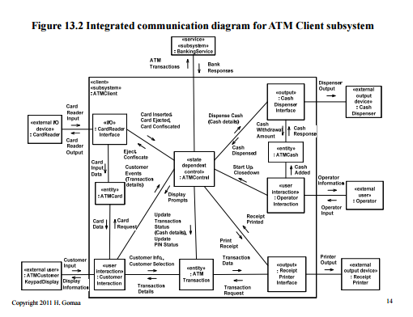
Example ATM Client
Superimpose other communication diagrams
Add new objects and new message interactions from each subsequent diagram
Objects and interactions that appear on multiple diagrams are only shown once
Consider alternative scenarios for each use case

Slide 7
Integration of Communication Diagrams
Subsystem communication diagram
High-level communication diagram
Shows subsystems and their interactions
Integrated communication diagram
If there are too many objects for one integrated communication diagram
Develop subsystem communication diagram
Develop integrated communication diagram for each subsystem

Slide 8
Green Zone Monitoring Project
Work on:
Deliverable 6 – Phase 1, f – Due Thursday, March 30, 2017 @ 2pm
Deliverable 7 – Phase 2, a – Due Tuesday, April 4, 2017 @ 2pm

Slide 9
Announcements
Reading Assignment – Chapters 12 and 13
Exam 3 – Thursday, March 30, 2017 in-class (Cumulative: Chapters 1 – 13)
No class on Tuesday (4/4) – at home assignment will be posted in Canvas by Monday evening (4/3)
Moving forward, class time will be devoted to Green Zone Monitoring Project work

